Slide 1
Flexible Mechanical Elements
ME 313: Mechanical Design
Week 8

Slide 2
What are Flexible Mechanical Elements?
Elastic elements used in conveying and transmission of power
Belts, ropes, chains, etc..
Used to transmit power over long distance
Replace gears, shafts, and/or bearings

Slide 3
Advantages of Using Flexible Elements
Absorb shock loads and isolate vibrations
Simplify design
Save cost

Slide 4
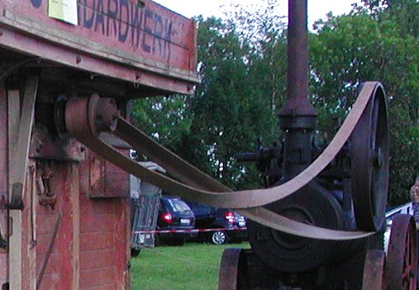
Belts
Usually coupled with pulleys
Cheapest method of power transmission
Shafts do not have to align
Very little noise
No lubrication and small maintenance required

Slide 5
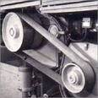
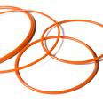


Types of Belts
Flat belts
Simple, flat rectangular cross section
Round belts
Circular cross section
V belts
Trapezoidal cross section
Timing Belts
Have teeth to match toothed pulley

Slide 6
Flat and Round Belt Drives
Belts usually consists of elastic core surrounded by an elastomer
C
d
D
Contact angles

Slide 7
Length of Belt
When the belts are crossed, contact angles are the same
And length is

Slide 8
Belt Tension
Assume belt mass is very small, pulley and belt has coefficient of friction μ and angle of contact θ
F₁: tight side
F₂: loose side

Slide 9
Torque Transmission
Torque transmission is related to the difference in belt tensions

Slide 10
Power Transmission
If belt is moving at speed v, then

Slide 11
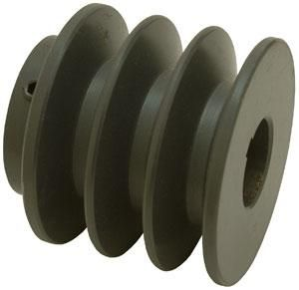
V Belts
Standard V belt cross section is usually 40 degree trapezoid
The pulleys also have grooves for belts to fit into
This allows the belt to fit further into the groove as belt tension increases
40°

Slide 12
Torque Transmission
Belt friction depends on the angle on the grooves
Groove Angles | Coefficient of Friction
30 | 0.5
34 | 0.45
38 | 0.4

Slide 13
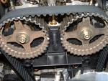
Timing Belts
Belt teeth to fit into grooves of pulley
Prevent slipping and eliminate need for initial belt tension
Transmits power at constant velocity
Require no lubrication, quiet operation
Attractive solution for precision-drive

Slide 14
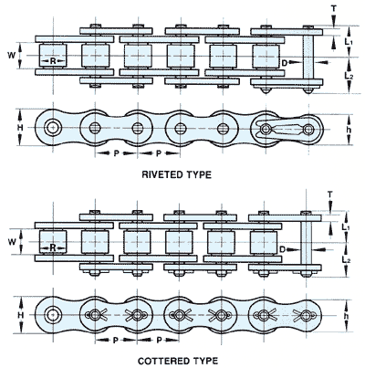
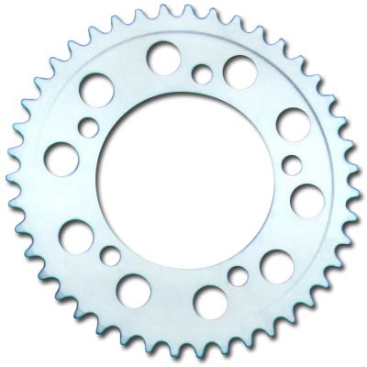
Roller Chains
Chains of constant pitch, coupled with a sprocket, for power transmission

Slide 15
Roller Chain Geometry
Pitch, p
Distance between adjacent chains
Pitch angle, γ
Angle between adjacent teeth

Slide 16
Sprocket Dimension
If there are N teeth on the sprocket, and roller chain has pitch p

Slide 17
Chain Velocity
v = chain velocity
N = number of sprocket teeth
p = chain pitch
n = rotational speed (in revolution/second)
However, chain velocity is not constant, due to sprocket uneven radius

Slide 18
Chordal Speed Variation
The variation in speed is
This is called the chordal speed variation

Slide 19
Chain Failure
Chains seldom fail because they lack tensile stress
There mode of failure is usually from long hours of service due to wear on the rollers or pins and fatigue of rollers

Slide 20
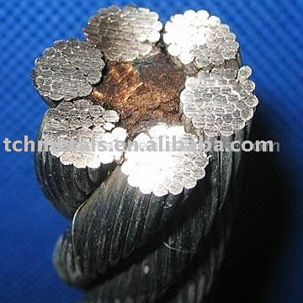
Wire Rope
Made up of windings of wire into strands, and of strands into rope
Many uses especially in very long and heavy load carriers
Elevators
Mineshafts

Slide 21
Stress in Wire Rope
From beam bending
M = bending moment
κ = curvature
E = Young’s modulus
I = moment of inertia
R = radius of curvature
c = furthest distance from neutral axis
E_{r} = Young’s modulus of rope
d_{w} = wire diameter
D = sheave diameter (radius of curvature of wire rope)

Slide 22
Importance of Pulley Diameter vs Rope Diameter
The smaller the pulley diameter, the higher the bending stress
When analyze stress in the rope, must consider both tensile and bending stress
General rule:
e.g. mine shafts and elevators, the ratio goes from 800-1000

Slide 23
Elevator Problem
Assume rope is massless, rope tension due to load acceleration-deceleration is
W is weight at the end of the rope
n is the number of wire ropes supporting the load
Therefore the total stress in the rope is

Slide 24
Questions?

